Slide 1

Big Data

Slide 2

Conceptos
Cuando hay big data?
2
Bases de Datos NoSQL
3
Categorias y ejemplos
Diferencias con RDBMS
3 V’s
Teorema CAP
4
Que es Big Data?
1

Slide 3
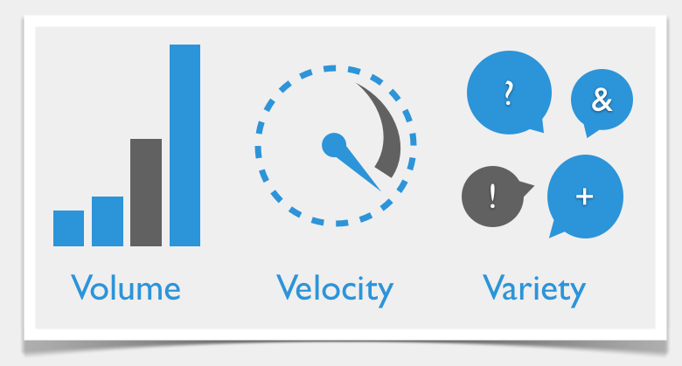
Big Data – 3 V’s

Slide 4
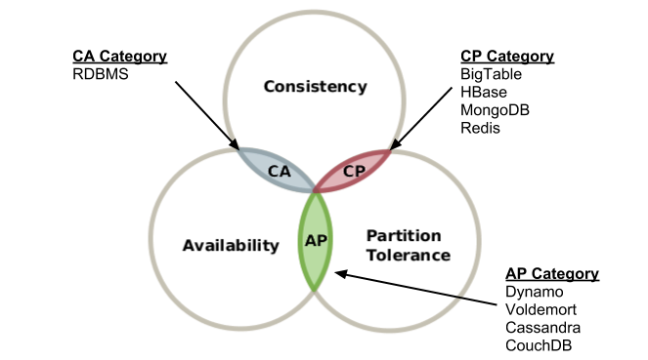
Big Data – Teorema CAP

Slide 5
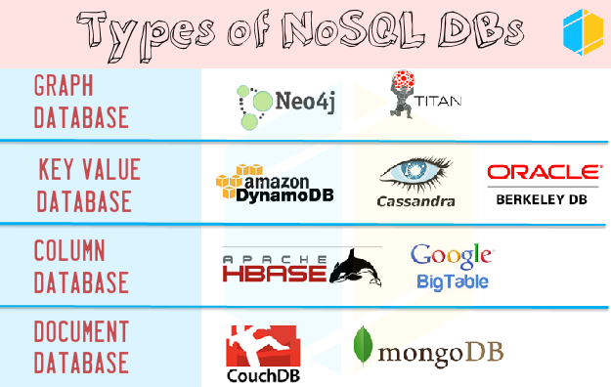
Big Data - NoSQL

Slide 6
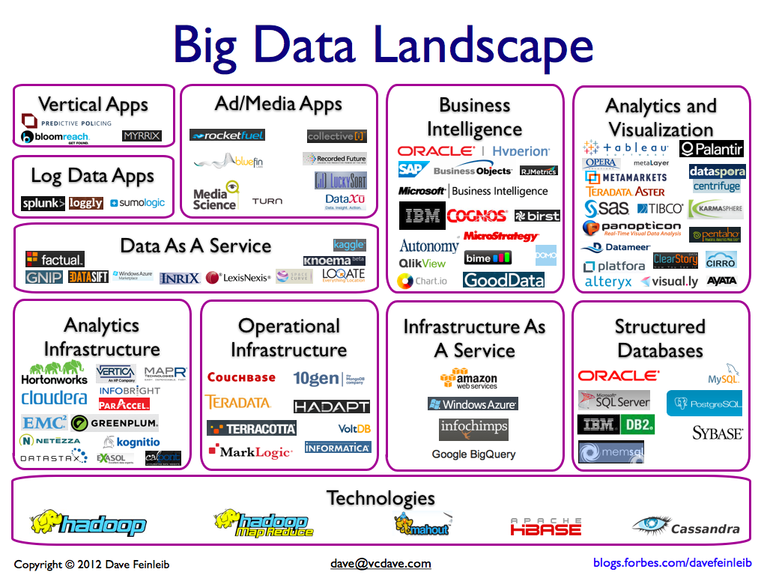

Slide 7

Apache Hadoop

Slide 8

Apache Hadoop
Que es / Casos de uso
Caracteristicas
Componentes
Landscape
Diferencias Hadoop 1 vs Hadoop 2
Cuando no usar Hadoop

Slide 9
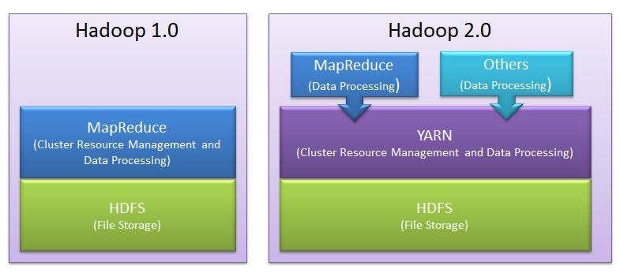
Hadoop

Slide 10
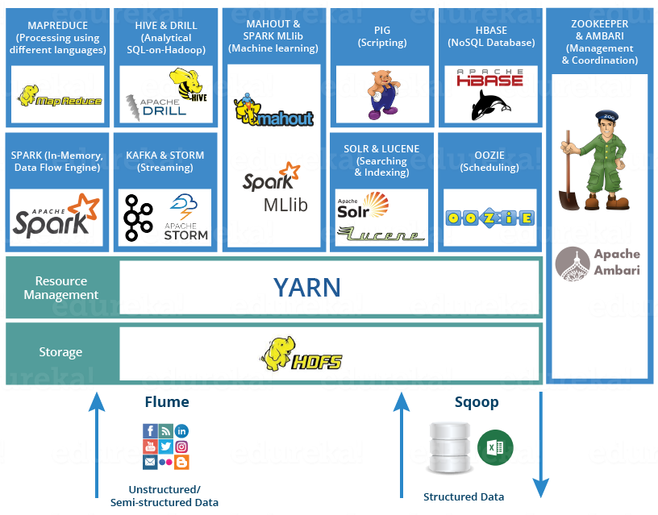
Hadoop Ecosystem

Slide 11

Map Reduce

Slide 12
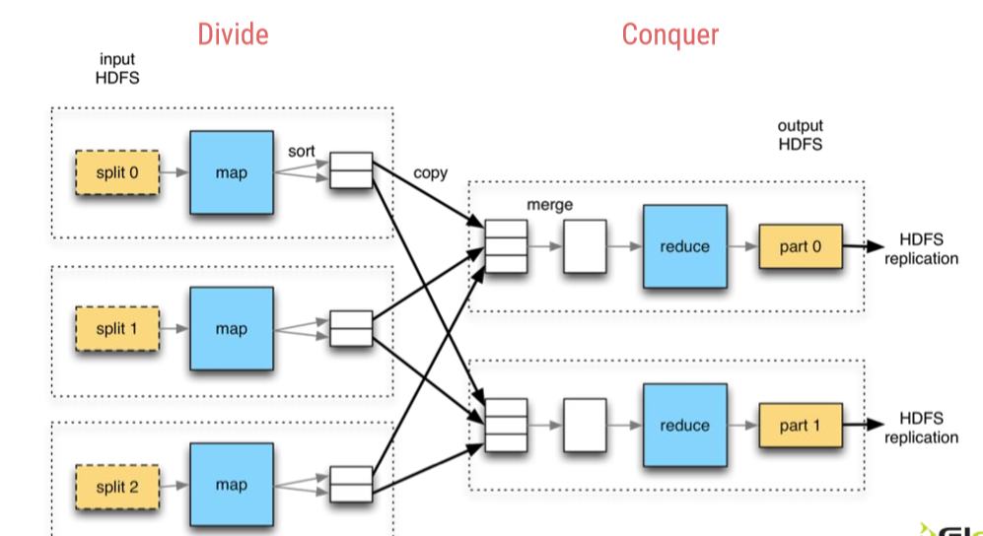

Slide 13

HDFS

Slide 14
Highly Distributed File System
HDFS
Que es?
Componentes
Namenode
Como funciona?
Arquitectura
Datanode
Componentes y funciones
Concepto bloque
Secondary Namenode
Problemas
SPOF → HDFS HA
NN RAM & blocks → HDFS Federation
Proceso
Write data
Read data

Slide 15
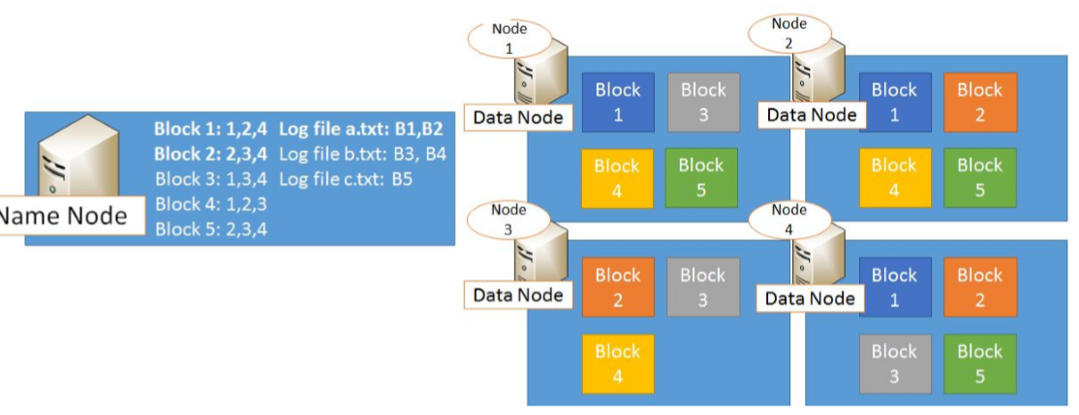
HDFS

Slide 16
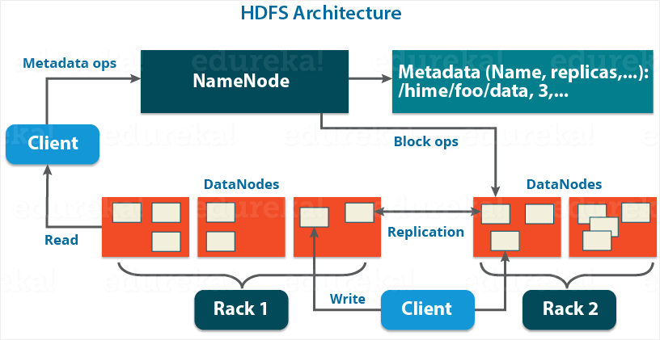
HDFS - Architecture

Slide 17
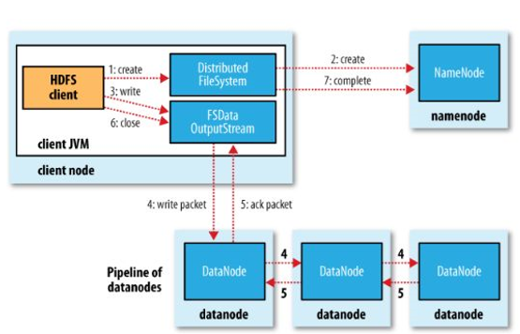
HDFS
Write data flow

Slide 18
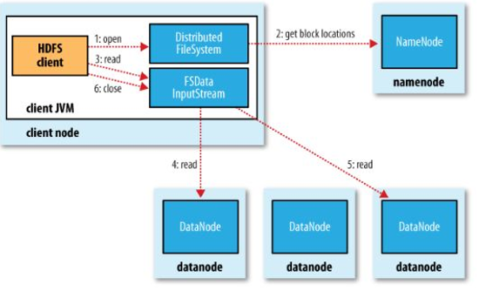
HDFS
Read data flow

Slide 19

Yarn

Slide 20
Yet Another Resource Manager
YARN
Que es?
Componentes
ResourceManager
Como funciona?
Arquitectura
Componentes y funciones
Concepto container
Problemas
Data Locality
NodeManager
ApplicationMaster
Scheduler
ApplicationManager
Proceso
Run job process
Yarn HA

Slide 21
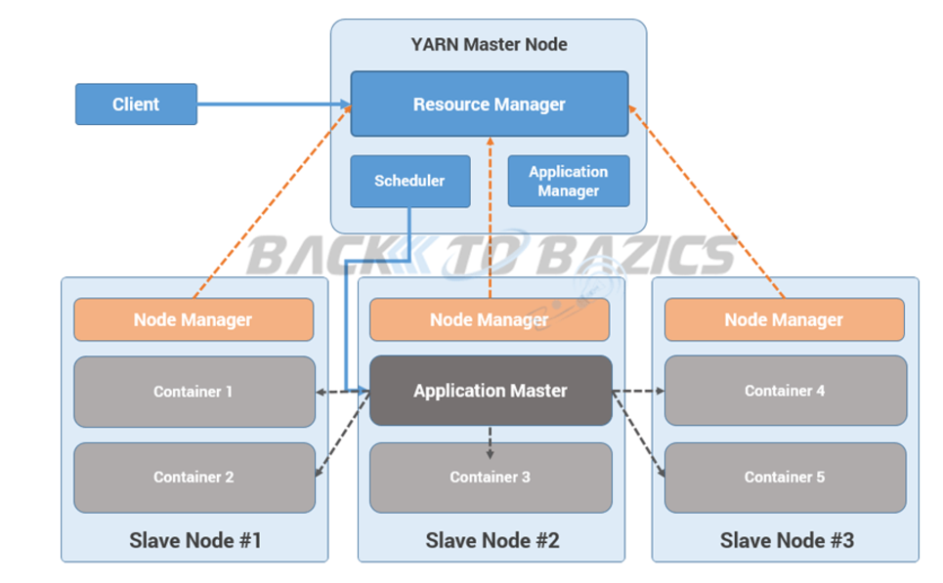
YARN
Run job process

Slide 22

Sqoop

Slide 23
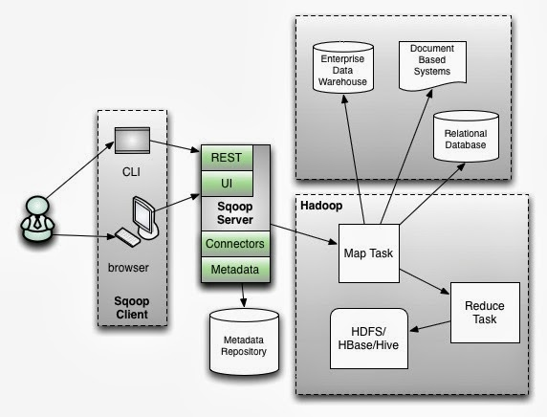

Sqoop

Slide 24
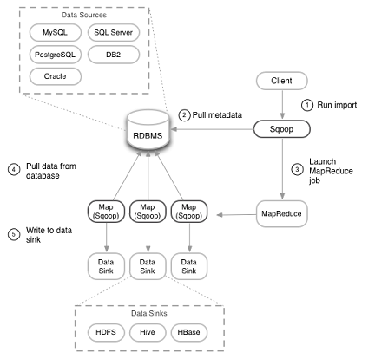
Sqoop
Import overview

Slide 25


Pig

Slide 26
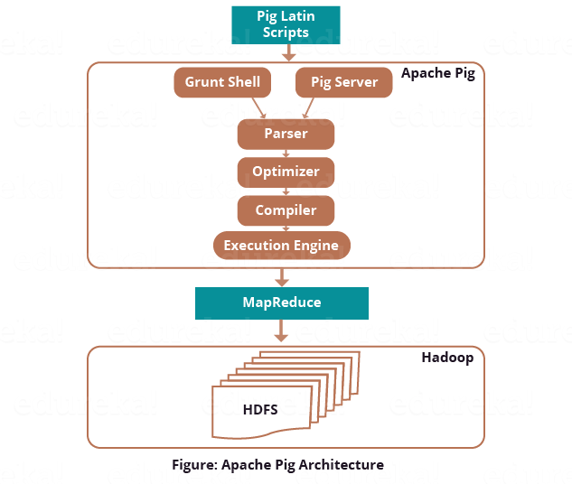
Pig

Slide 27

Hive

Slide 28
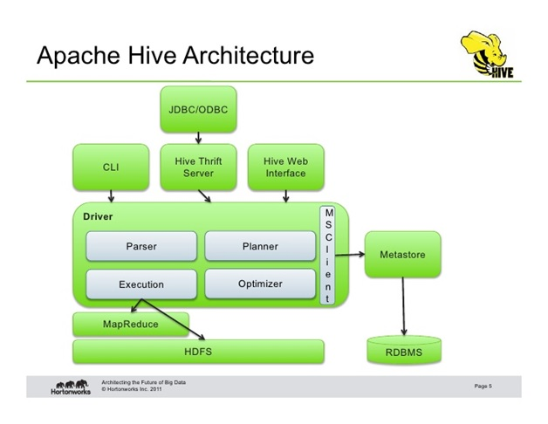
Hive

Slide 29
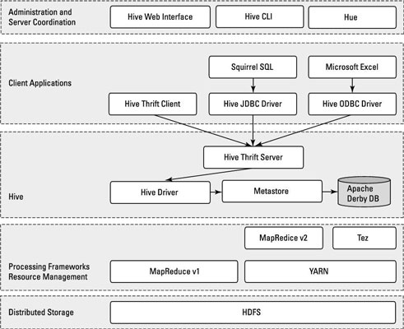
Hive

Slide 30

Spark

Slide 31
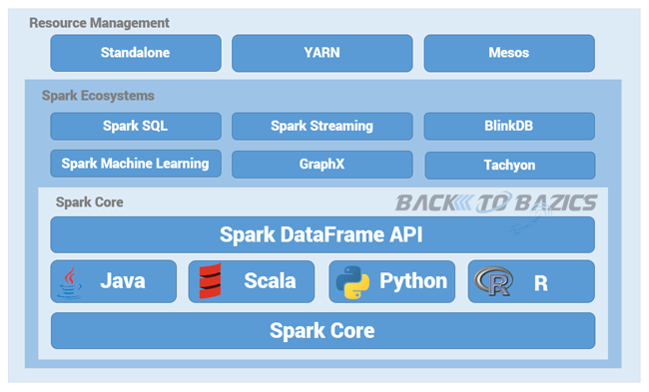
Spark

Slide 32
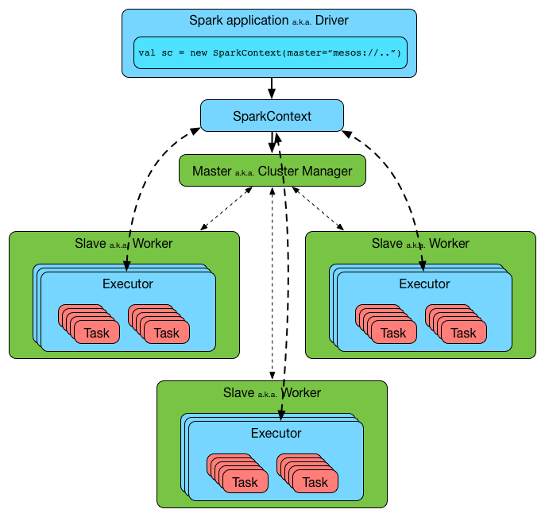
Spark

Slide 33
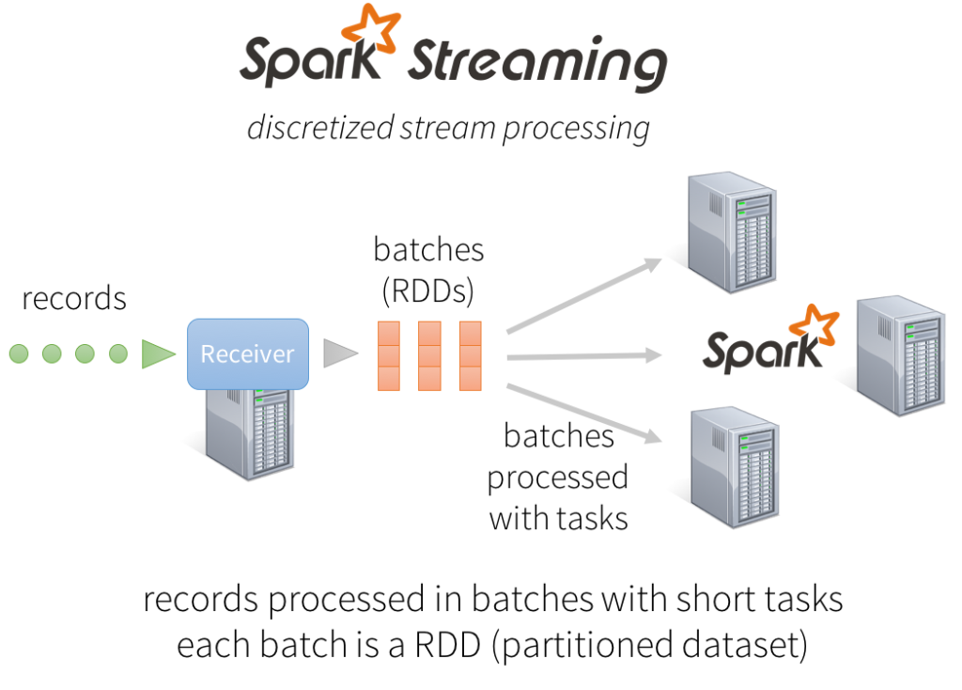

Slide 34
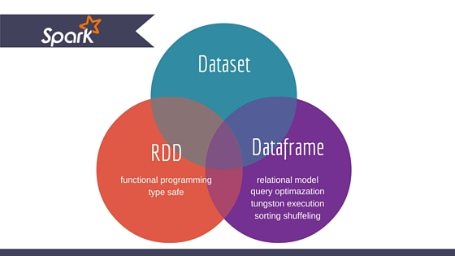
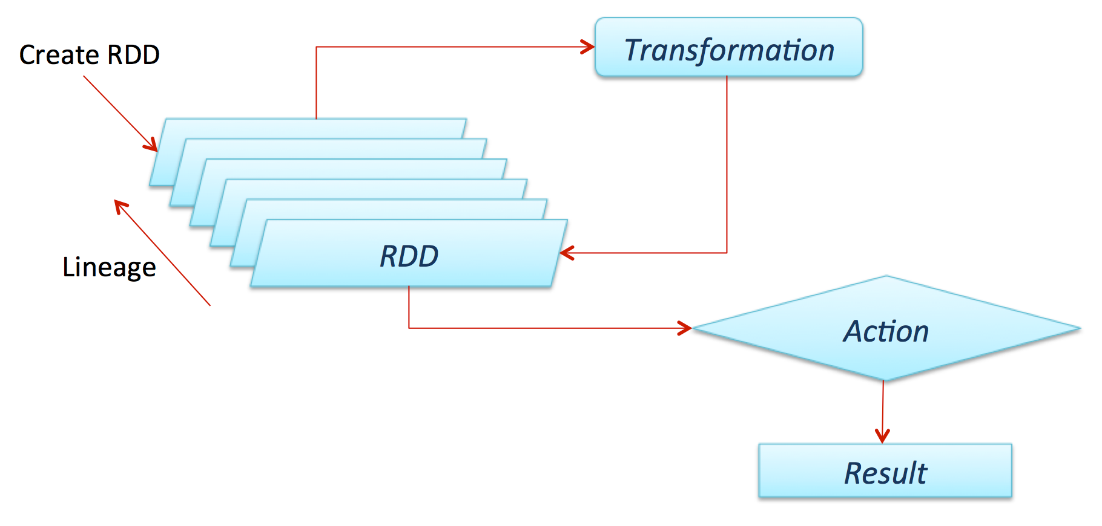
Spark Data

Slide 35

Lambda Architecture

Slide 36
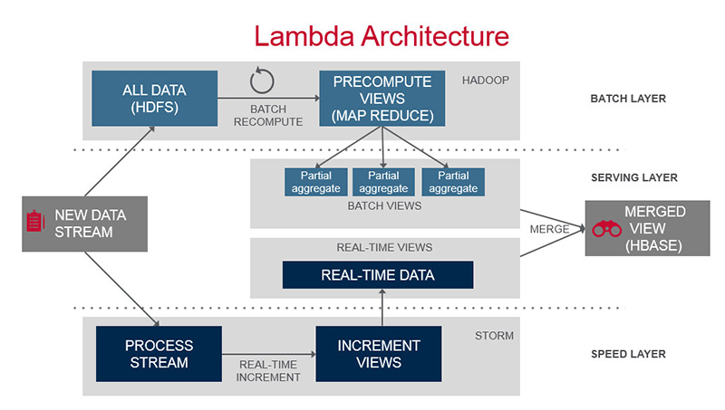
Lambda Architecture

Slide 37
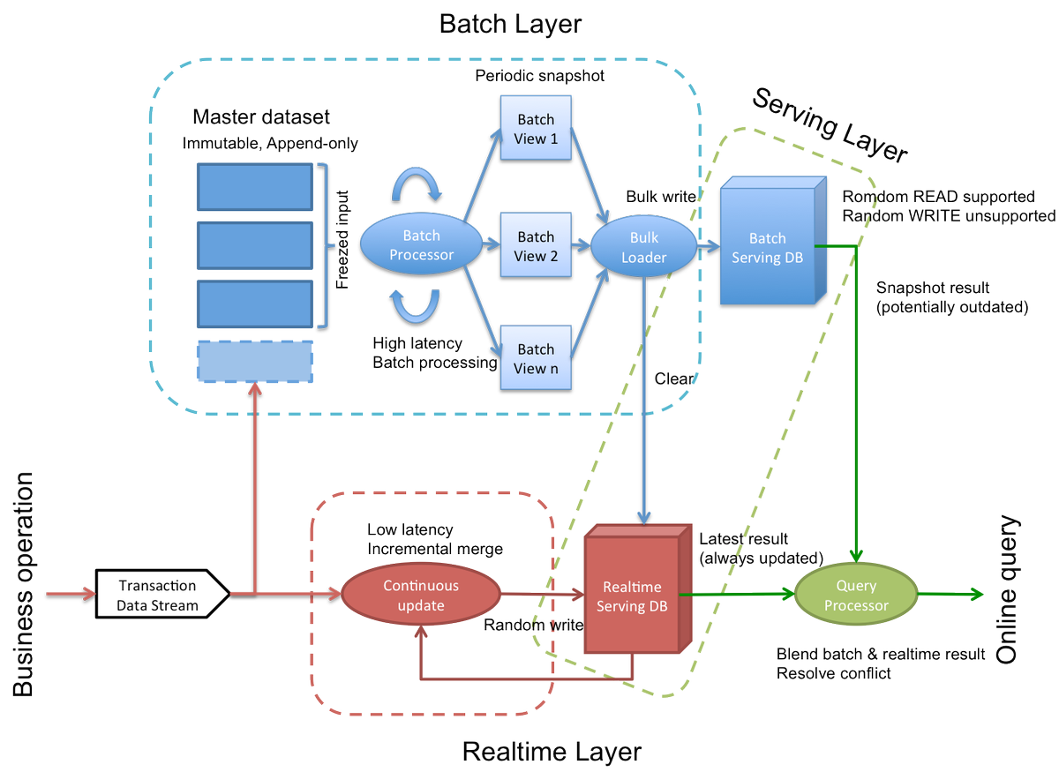

Slide 38
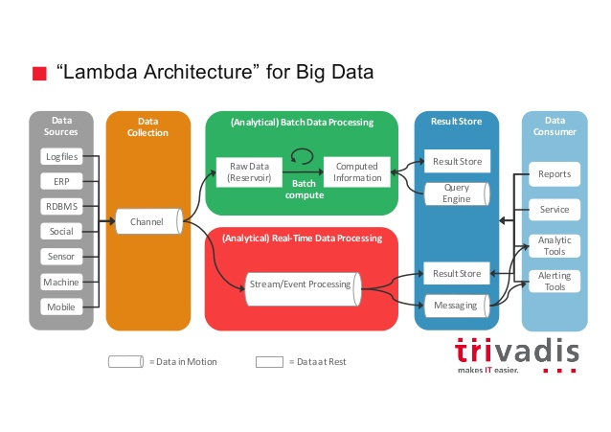

Slide 39

Kappa Architecture

Slide 40
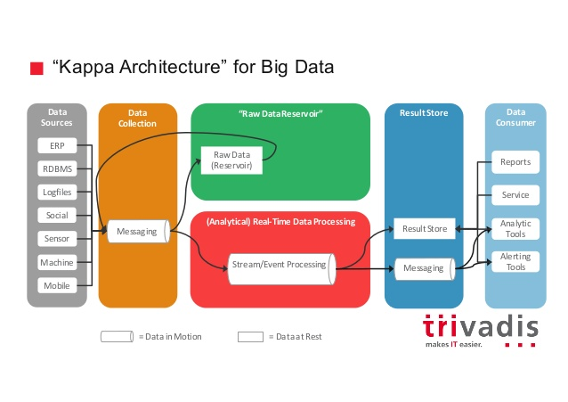

Slide 41

Flume

Slide 42
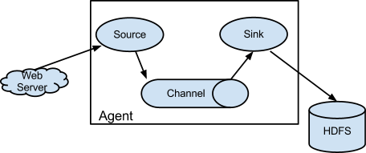
Flume

Slide 43
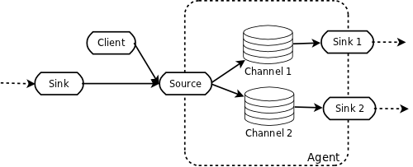
Flume pipeline

Slide 44
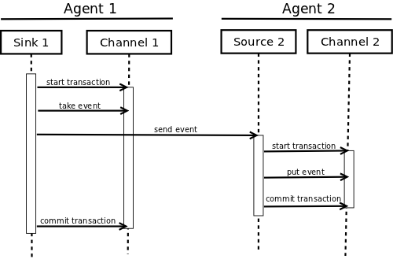
Flume – Agents transaction

Slide 45

Impala

Slide 46
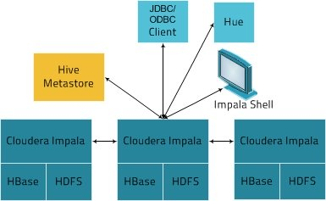
Impala

Slide 47

Cassandra

Slide 48
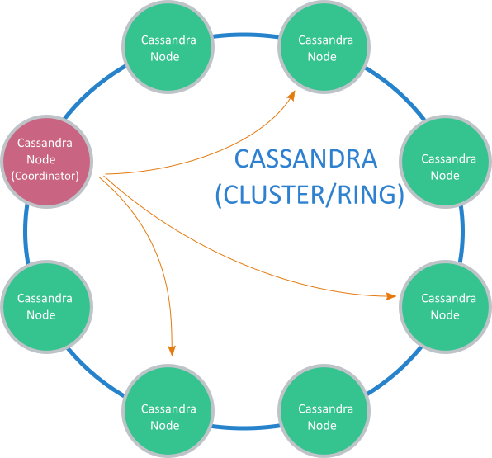
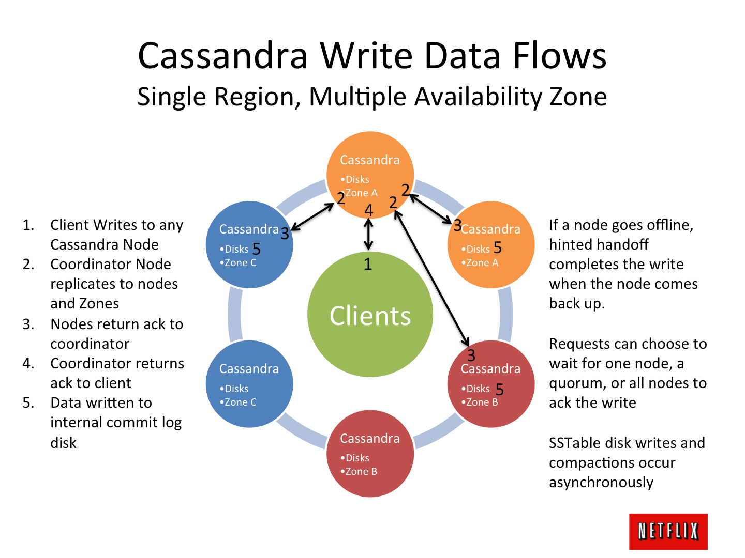

Slide 49
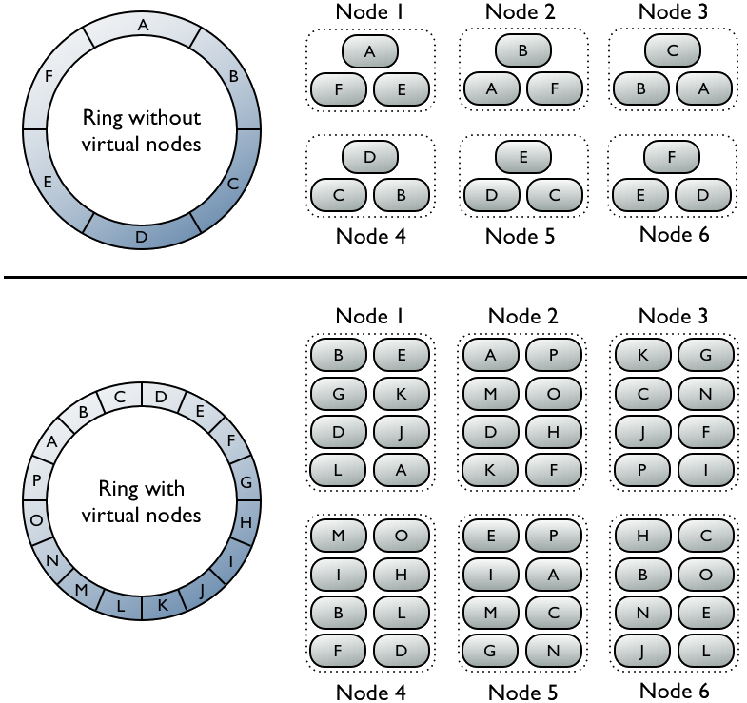

Slide 50

Tez

Slide 51
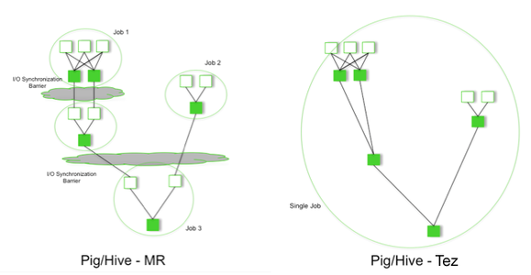
Tez

Slide 52

Mahout

Slide 53
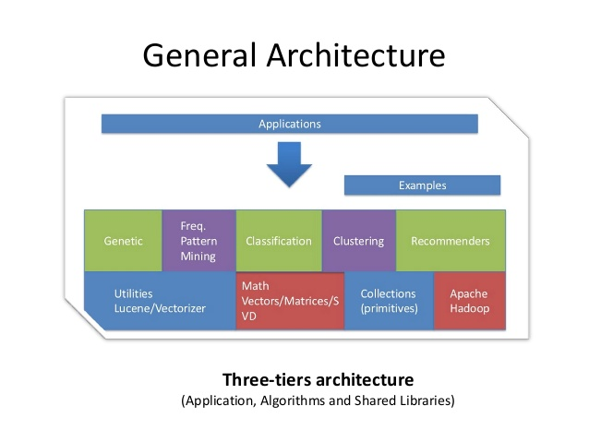
Mahout

Slide 54
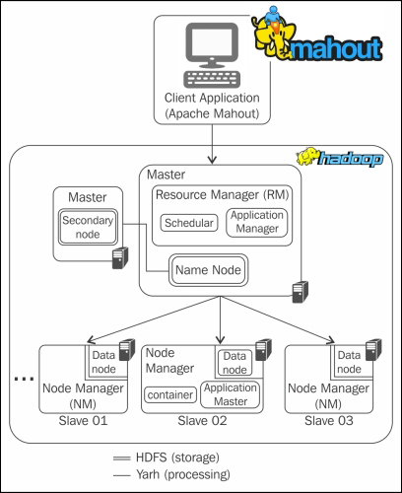

Slide 55

Flink

Slide 56
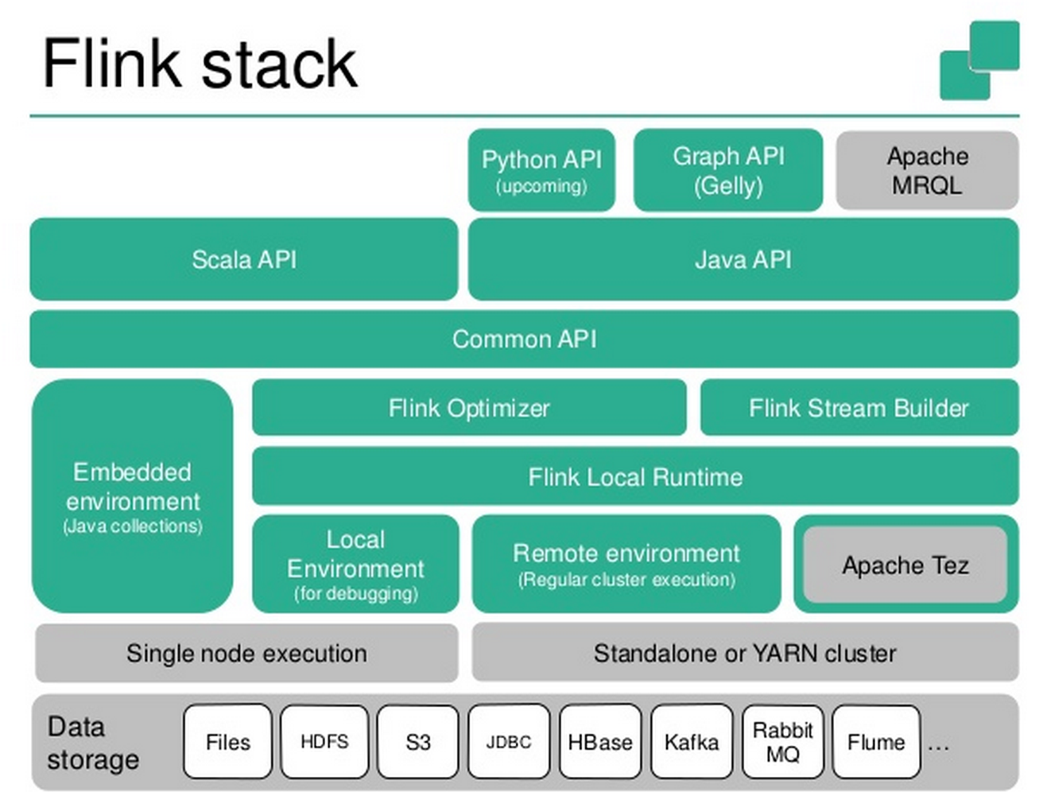

Slide 57
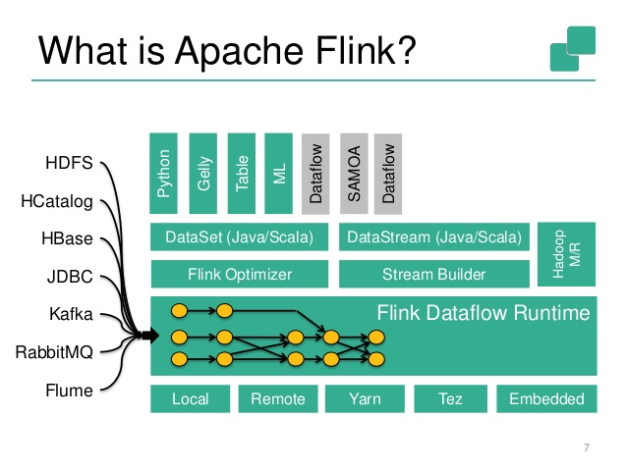

Slide 58
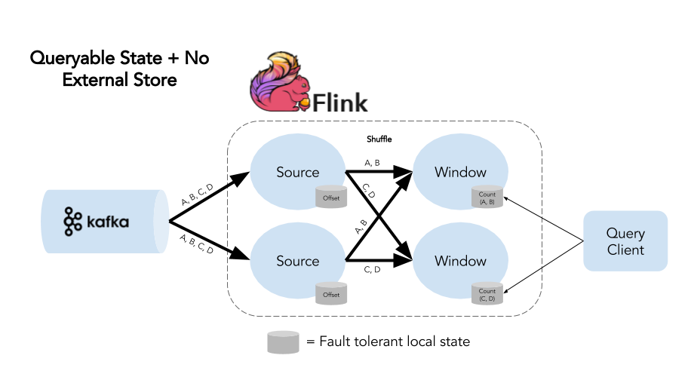
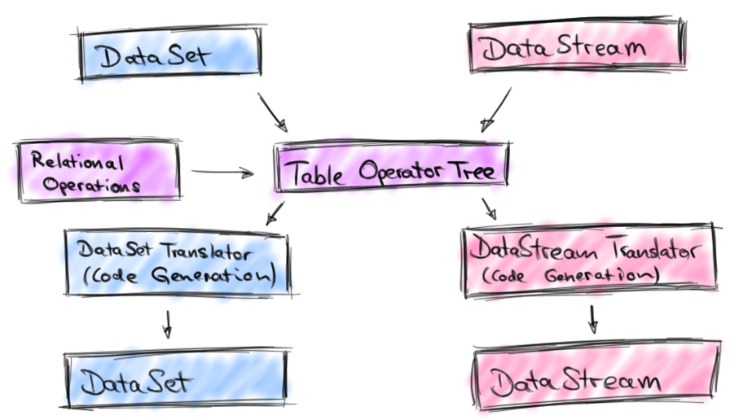

Slide 59

Apache Drill

Slide 60
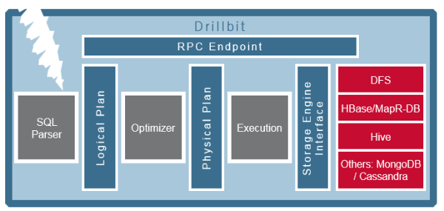
Apache Drill

Slide 61
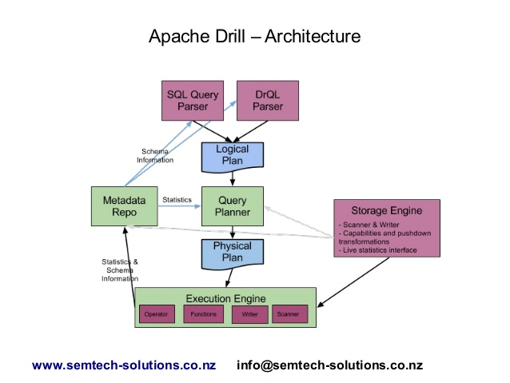
Apache Drill

Slide 62

MongoDB

Slide 63
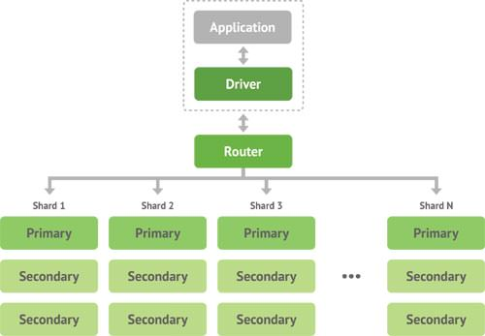
MongoDB

Slide 64
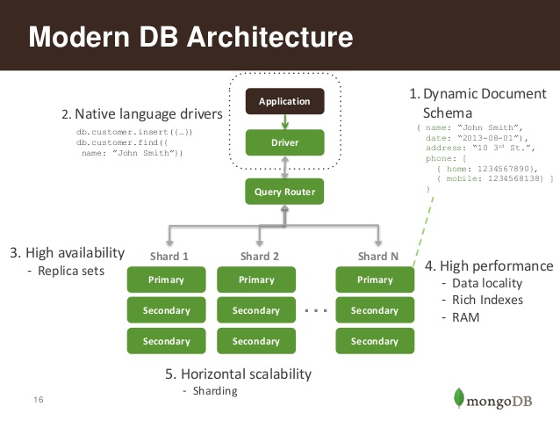
MongoDB

Slide 65

Apache Ambari

Slide 66
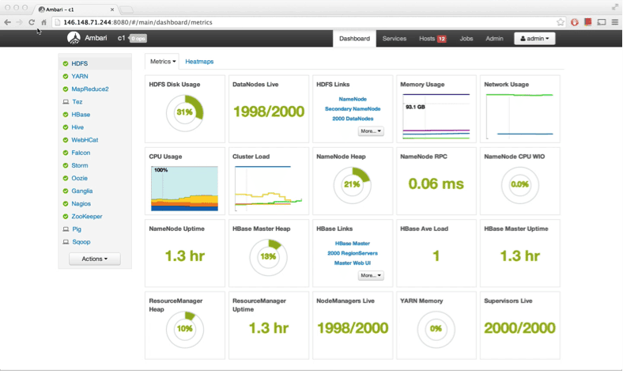

Slide 67

Hue

Slide 68
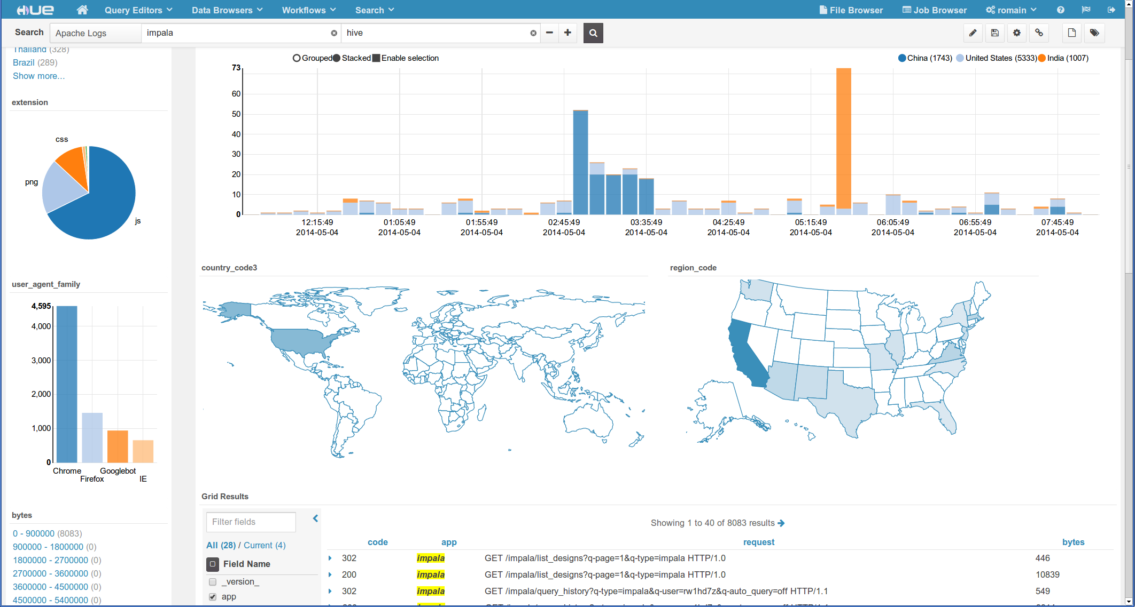

Slide 69

Storm

Slide 70
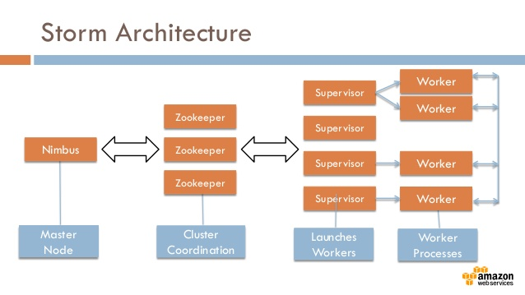

Slide 71
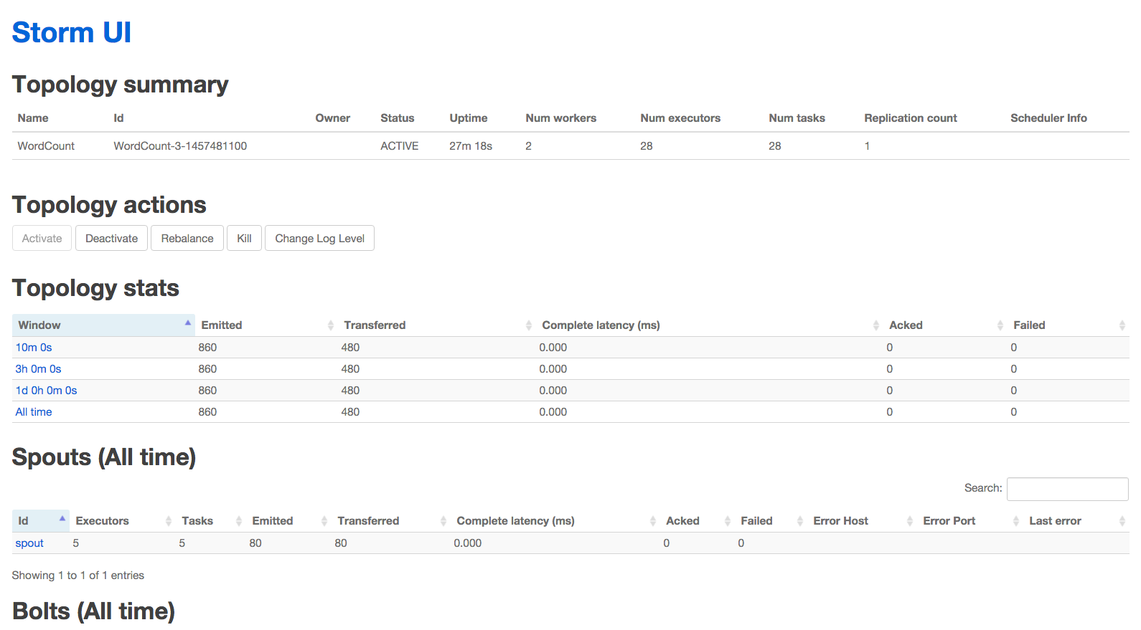

Slide 72

HBase

Slide 73
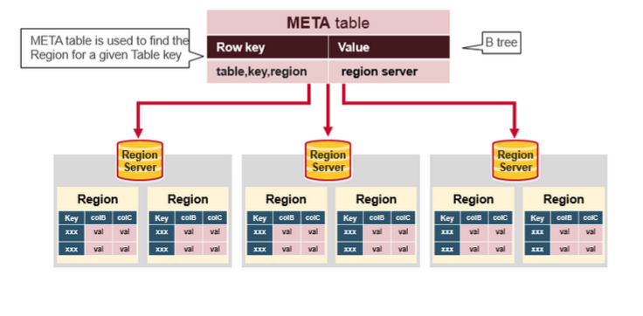
HBase

Slide 74
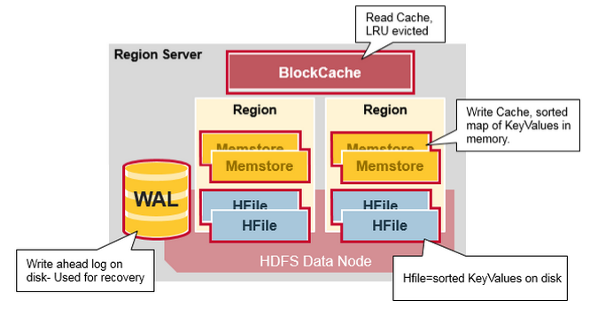
HBase

Slide 75

Hbase Cluster

Slide 76

Zookeeper

Slide 77


Slide 78

Kafka

Slide 79

Kafka

Slide 80

Oozie

Slide 81


Slide 82

Oozie workflow

Slide 83

Avro

Slide 84

Avro
Object container file

Slide 85

Amazon Web Services

Slide 86


Slide 87


